Slide 1
January Update

Slide 2
Goals
Achieve 90% accuracy on Wood et al’s dataset on 1 of model

Slide 3
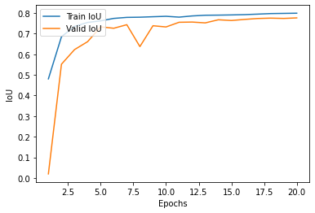
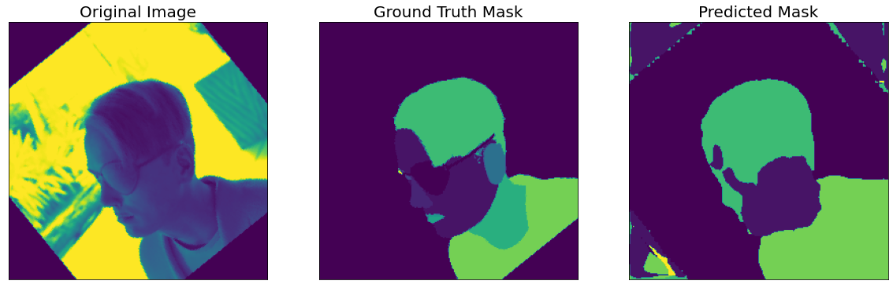
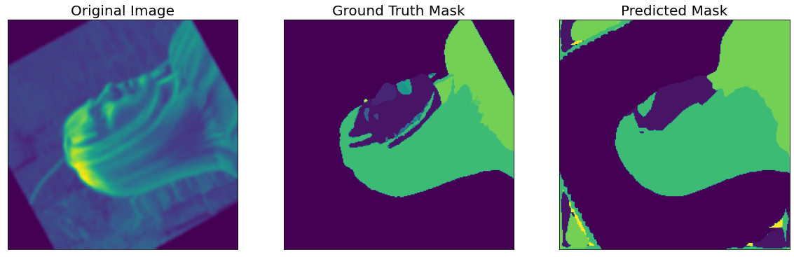
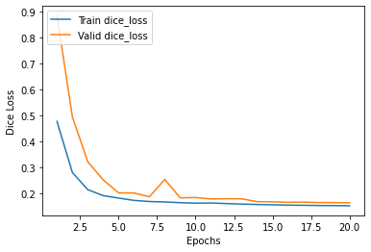
DeepLabV3+
Sample size: 1000
Batch size: 100
Epochs: 20
Resolution: 255
Augmented: all
Alpha: 0.001
ENCODER = 'resnet101'
ENCODER_WEIGHTS = 'imagenet'
Params: 42M
Layers: 101
dice_loss - 0.1629, iou_score - 0.7764]

Slide 4
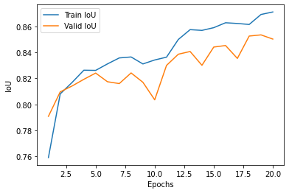
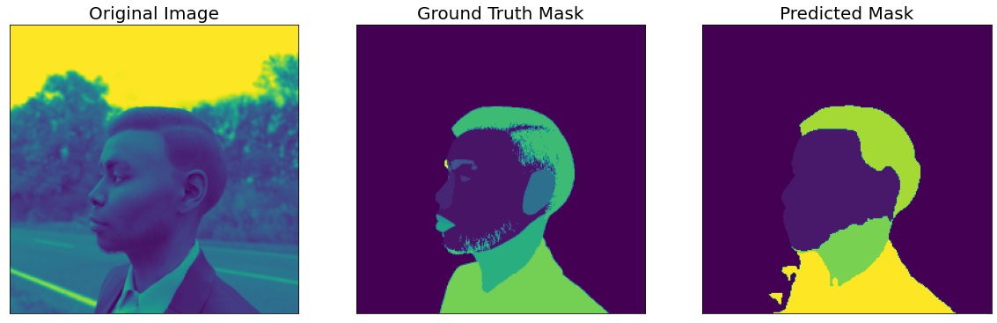
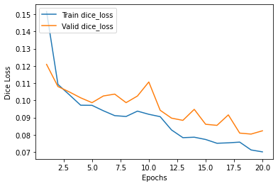
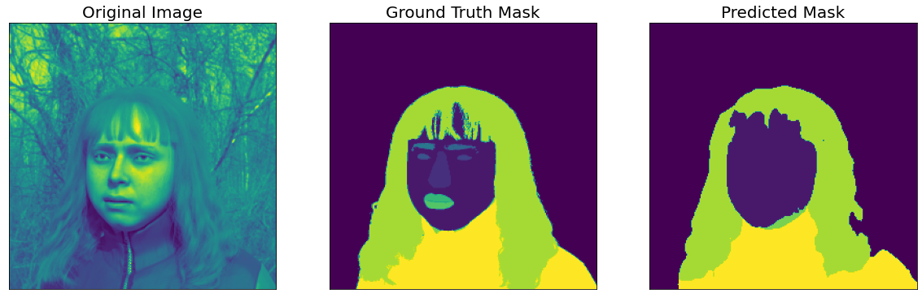
DeepLabV3+
Sample size: 1000
Batch size: 2
Epochs: 20
Resolution: 255
Augmented: none
Alpha: 0.001
ENCODER = 'resnet101'
ENCODER_WEIGHTS = 'imagenet'
Params: 42M
Layers: 101
dice_loss - 0.08231, iou_score - 0.8503]

Slide 5
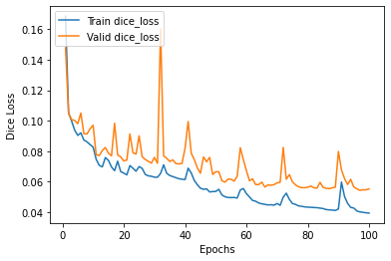
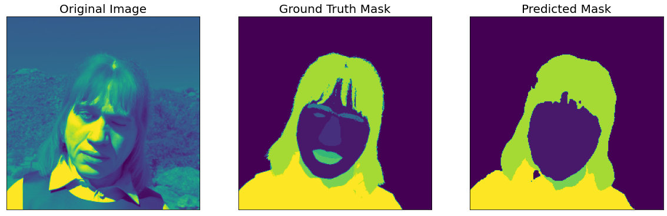

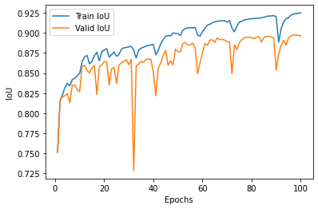
DeepLabV3+
Sample size: 1000
Batch size: 5
Epochs: 100
Resolution: 255
Augmented: none
Alpha: 0.001
ENCODER = 'resnet101'
ENCODER_WEIGHTS = 'imagenet'
Params: 42M
Layers: 101
dice_loss - 0.08231, iou_score - 0.8503]

Slide 6
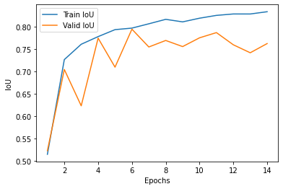

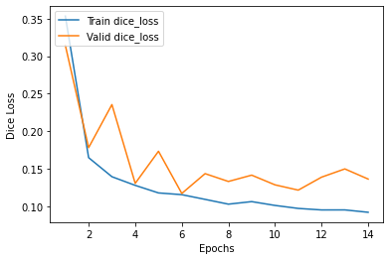
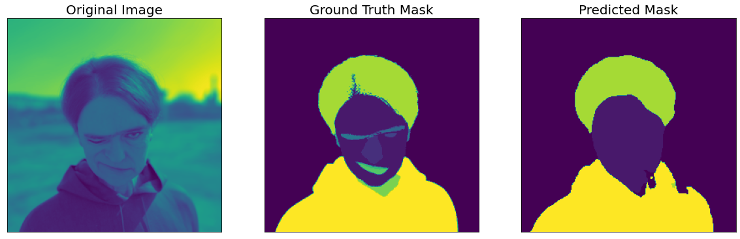
DeepLabV3+
Sample size: 1000
Batch size: 5
Epochs: 100
Resolution: 255
Augmented: none
Alpha: 0.001
ENCODER = 'resnext101_32x32d'
ENCODER_WEIGHTS = 'instagram'
Params: 466M
Layers: 101

Slide 7
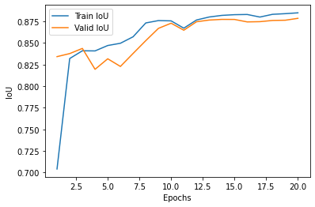
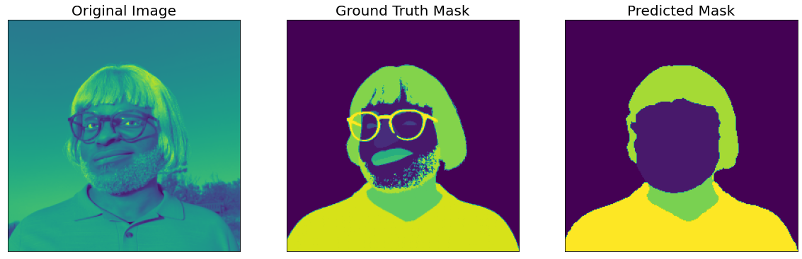
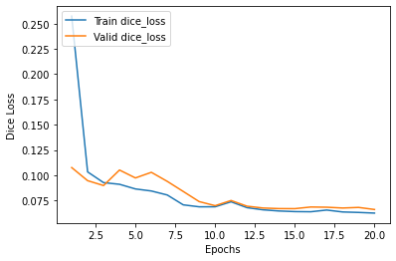
DeepLabV3+
Sample size: 1000
Batch size: 2
Epochs: 100
Resolution: 255
Augmented: none
Alpha: 0.001
ENCODER = Resnet101
ENCODER_WEIGHTS = None
Params: 466M
Layers: 101

Slide 8
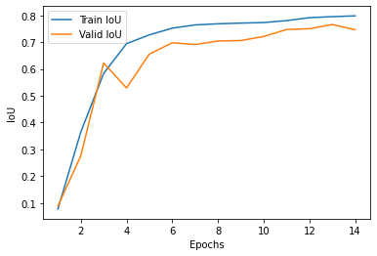
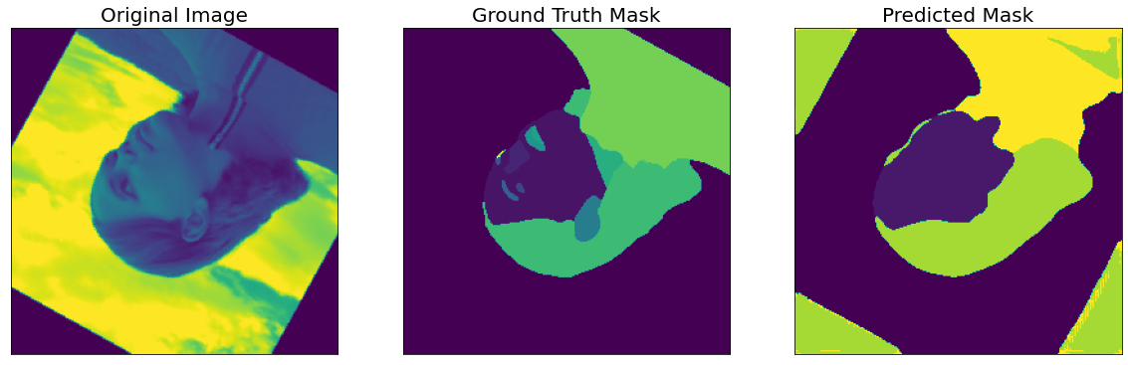
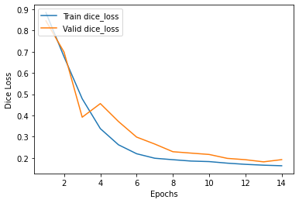
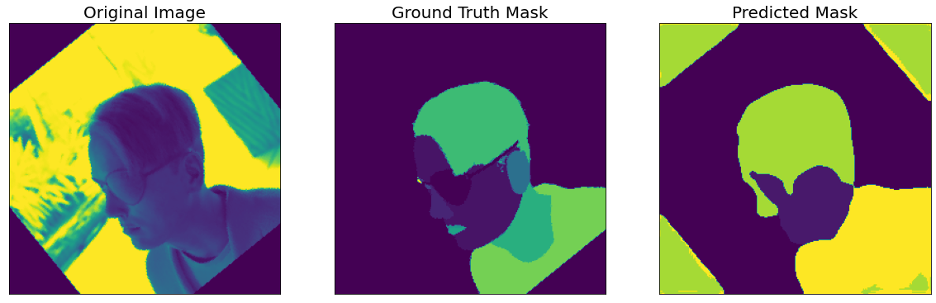
Unet
Sample size: 1000
Batch size: 100
Epochs: 15
Resolution: 255
Augmented: all
Alpha: 0.001
dice_loss - 0.1809, iou_score - 0.7595]

Slide 9
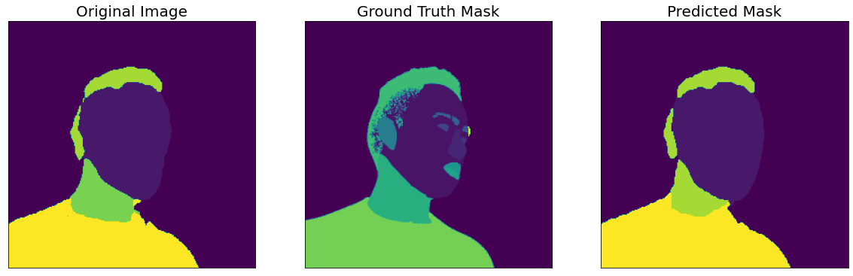
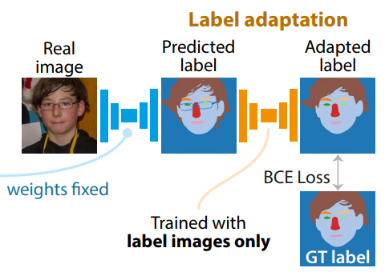
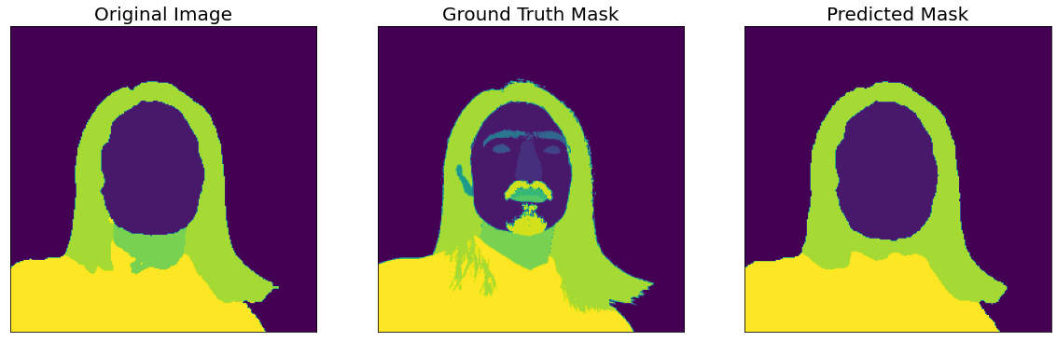
Label Adapter
MEAN IoU: 0.17426452

Slide 10
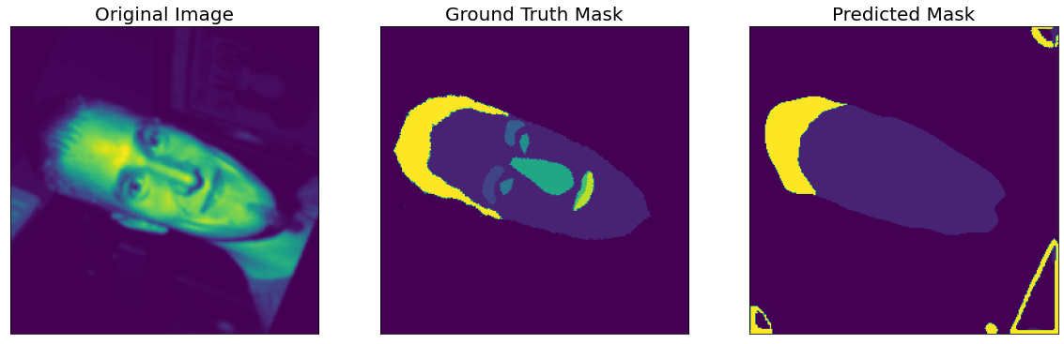
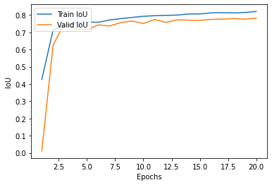
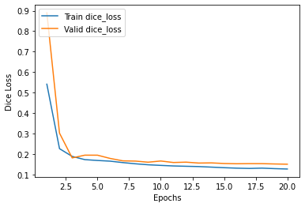
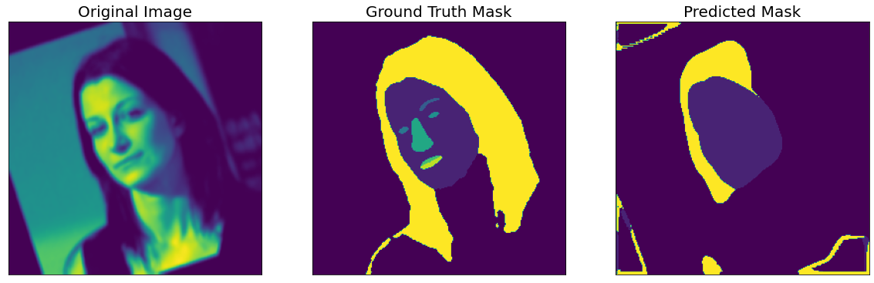
DeepLabV3+
Sample size: 2000
Batch size: 100
Epochs: 15
Resolution: 255
Augmented: all
Alpha: 0.001
dice_loss - 0.1501, iou_score - 0.7819]

Slide 11
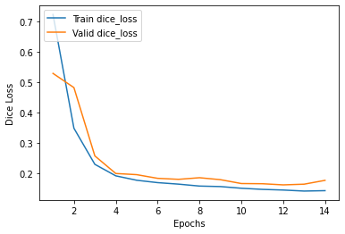
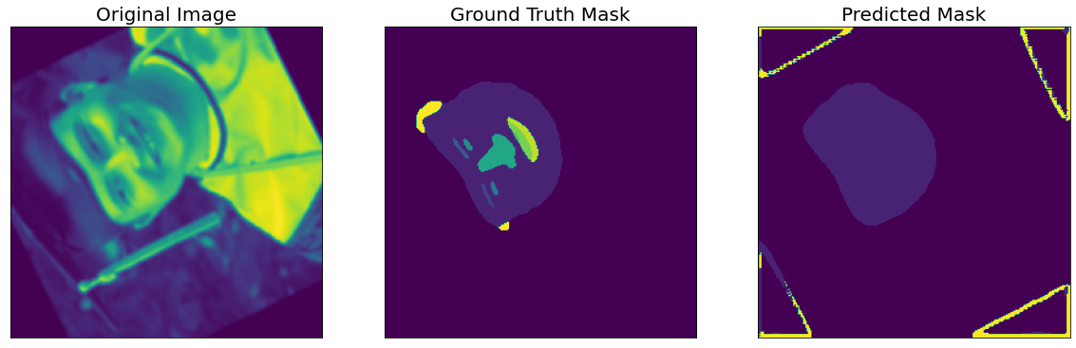
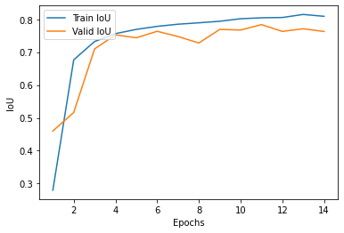
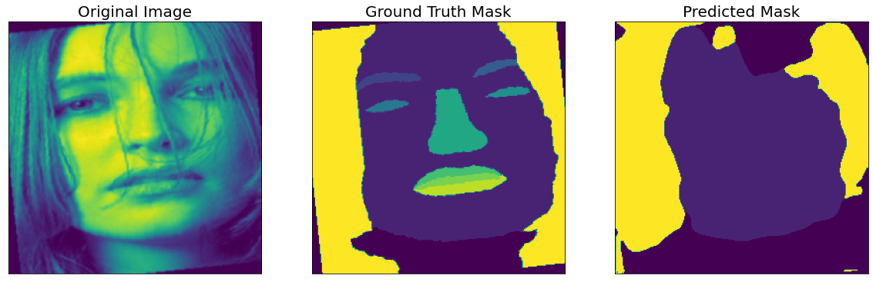
Unet
Sample size: 2000
Batch size: 100
Epochs: 15
Resolution: 255
Augmented: all
Alpha: 0.001
dice_loss - 0.1787, iou_score - 0.7591]

Slide 12
January 2nd Update

Slide 13
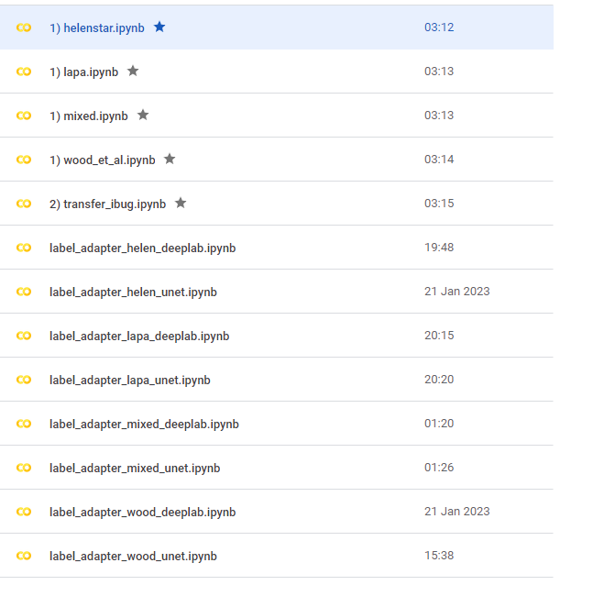

Slide 14
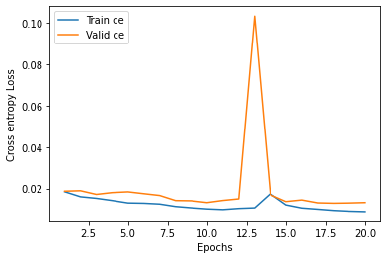
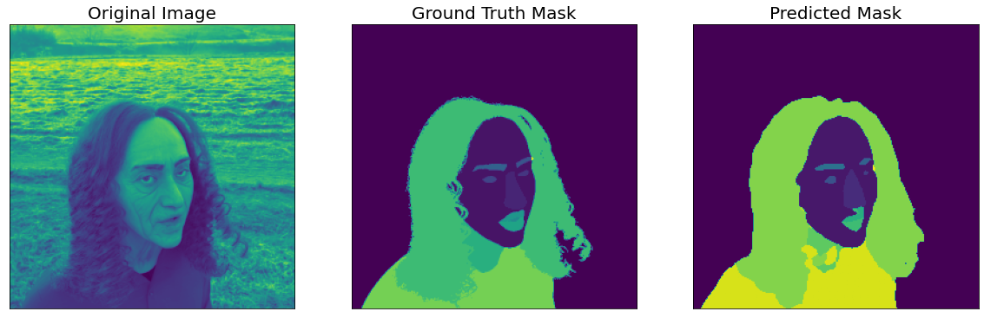
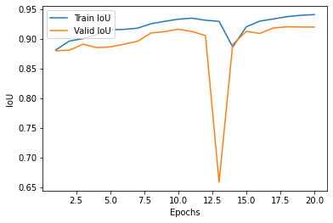
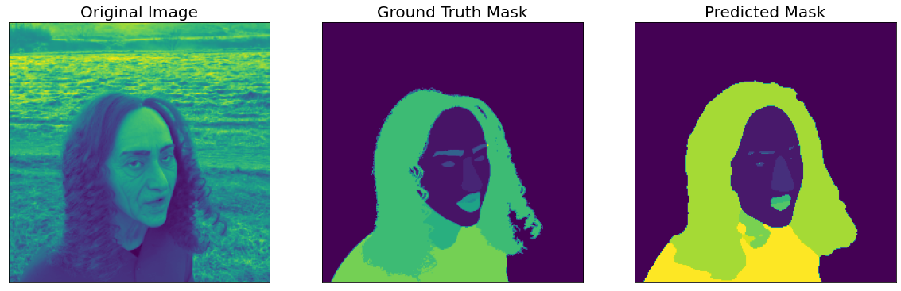
Milestones:
Models are successfully segmenting core facial features (eyes, nose, lips etc…)
This was achieved by changing the loss function to BCE
DeepLabv3+
MEAN IoU: 0.40498897
UNET
MEAN IoU: 0.3483375

Slide 15
Goals
Label Adapter
Wood et al
Deep lab
Unet
FCN
MOBILE
Helen*
Deeplab
Unet
FCN
MOBILE
LaPa
Deeplab
Unet
FCN
MOBILE
Domain-Mixed
Deeplab
Unet
FCN
MOBILE
Transfer-Learning (iBugMask)
Wood et al
Deep lab
Unet
FCN
MOBILE
Helen*
Deeplab
Unet
FCN
MOBILE
LaPa
Deeplab
Unet
FCN
MOBILE
Domain-Mixed
Deeplab
Unet
FCN
MOBILE
TRAINING
Wood et al
Deep lab
Unet
FCN
MOBILE
Helen*
Deeplab
Unet
FCN
MOBILE
LaPa
Deeplab
Unet
FCN
MOBILE
Domain-Mixed (80:70:60:50)
Deeplab
Unet
FCN
MOBILE

Slide 16
Transfer Learning Results
Model | iBugMask IoU
DeepLabV3+ | 0.06605199449793533
Unet | 0.06802583024468836
FCN
Mobile
Model | iBugMask IoU
DeepLabV3+ | 0.26385432248935103
Unet | 0.28815688472241163
FCN
Mobile
Model | iBugMask IoU
DeepLabV3+ | 0.2252277098596096
Unet | 0.24562857300043106
FCN
Mobile
Model | iBugMask IoU
DeepLabV3+ | 0.22062767716124654
Unet | 0.22062767716124
FCN
Mobile
Synth Trained
Helen Trained
Lapa Trained
Mixed Trained

Slide 17
Label Adapter Results
Model | Valid IoU | Adapter Valid IoU
DeepLabV3+ | 0.8472 | 0.8661
Unet | 0.8128 | 0.8637
FCN
Mobile
Model | Valid IoU | Adapter Valid IoU
DeepLabV3+ | 0.8466 | 0.8609
Unet | 0.8469 | 0.8357
FCN
Mobile
Model | Valid IoU | Adapter Valid IoU
DeepLabV3+ | 0.8676 | 0.8279
Unet | 0.8642 | 0.8624
FCN
Mobile
Model | 80% Valid IoU | 70% Valid IoU | 60% Valid IoU | 50% Valid IoU | Adapter Valid IoU
DeepLabV3+ | 0.840 | 0.8396 | 0.8401 | 0.8452 | 0.868
Unet |  |  |  | 0.8103 | 0.8506
FCN
Mobile
Synth Trained
Helen Trained
Lapa Trained
Mixed Trained

Slide 18
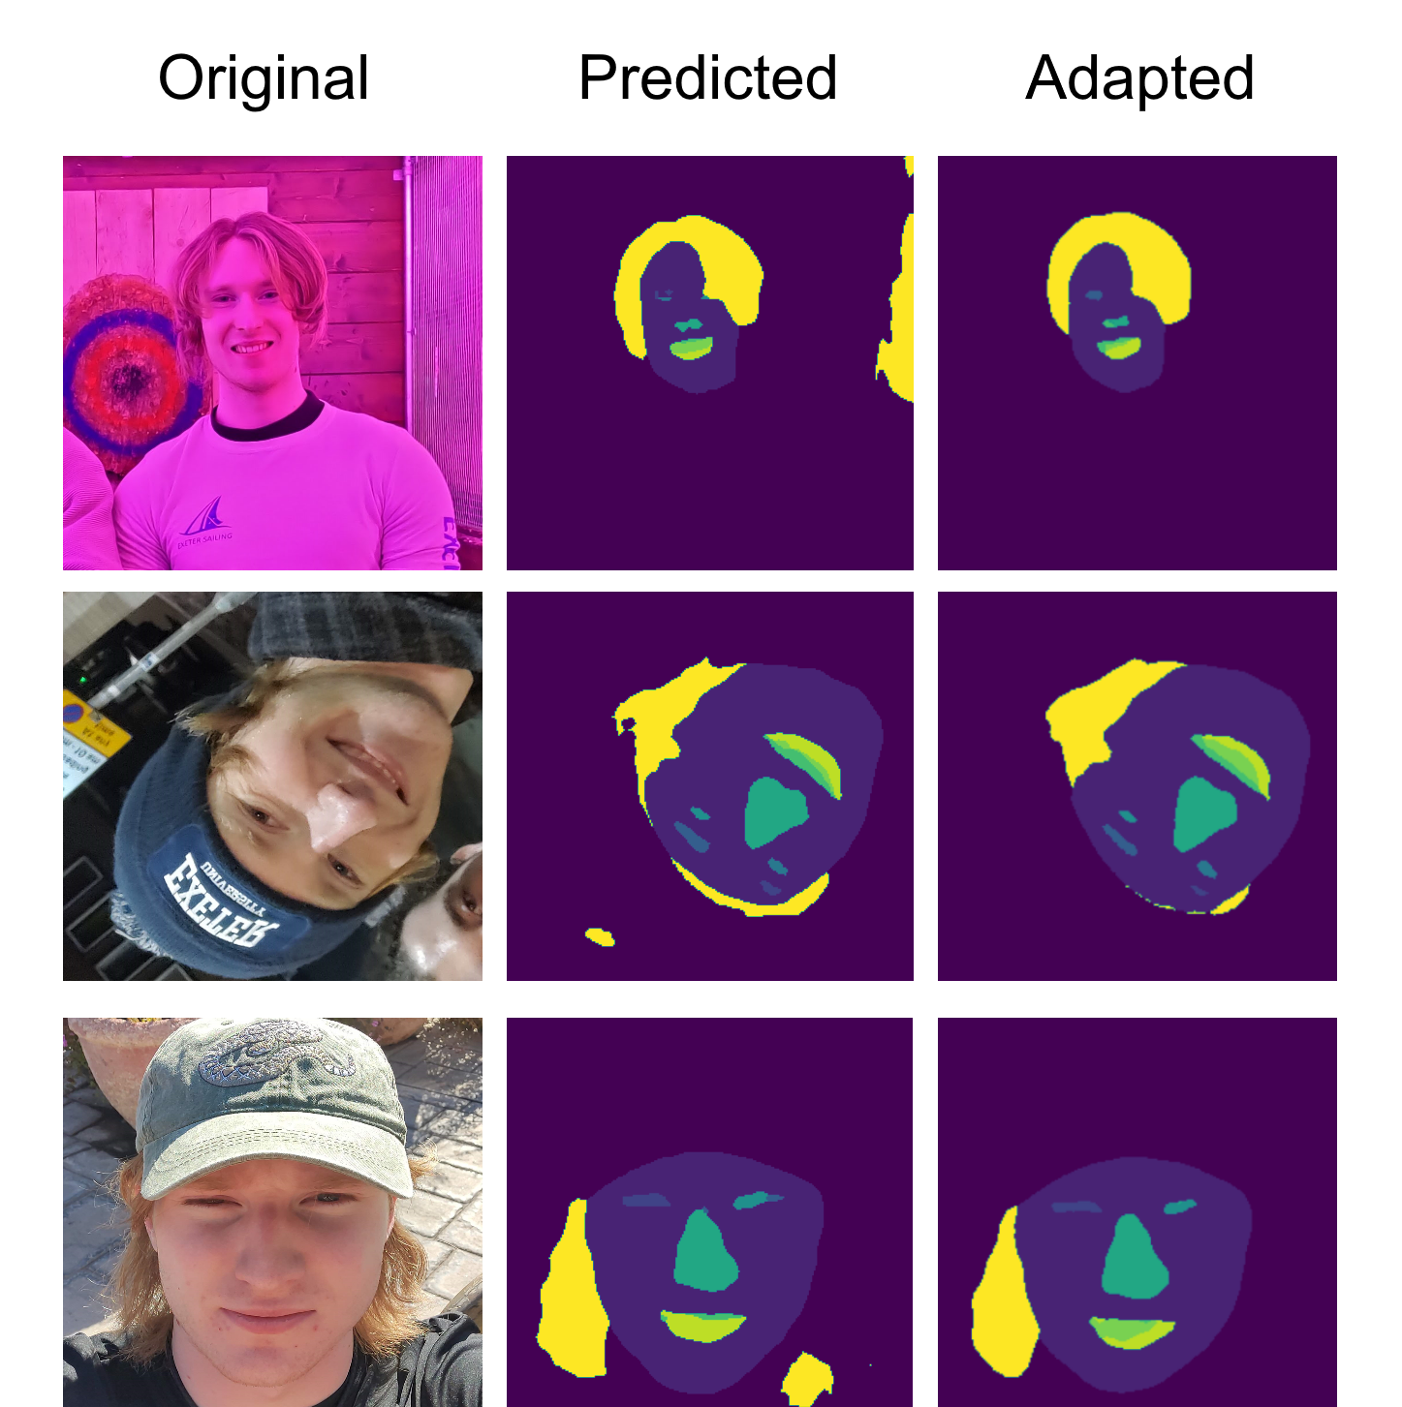
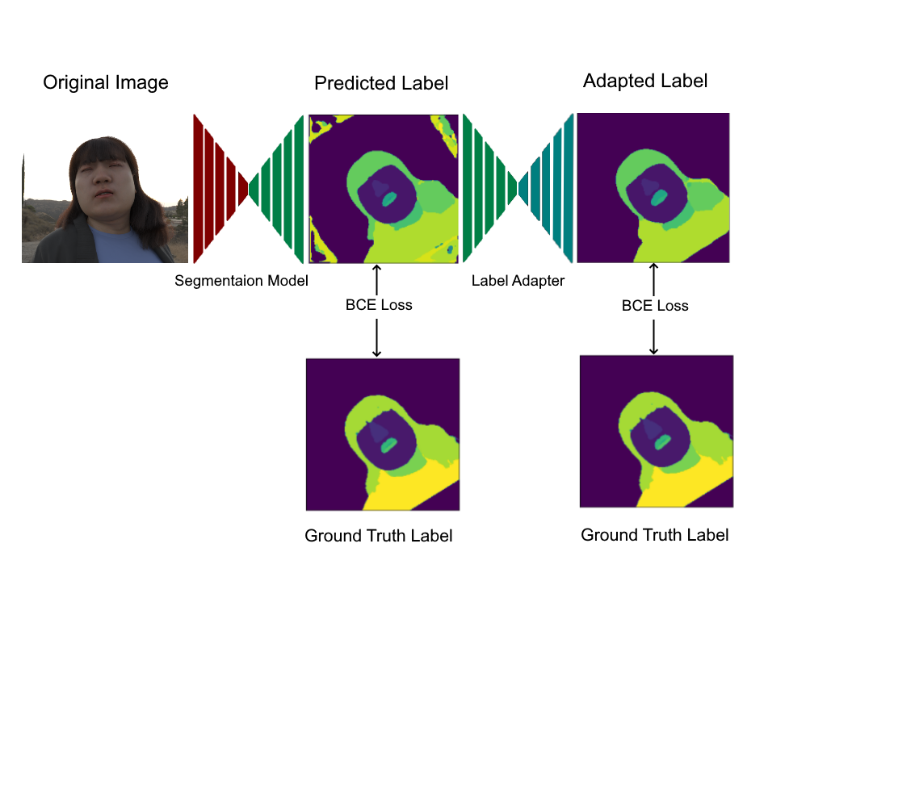

Slide 19
Hyper Parameters
DS Sample Size: 1000
Batch size: 80:80
Epochs: 50
LR: 0.001
Rotation : 0,180:100%
Warp: 0.0,0.9 : 40%
Blur: 5,9 : 30%
Brightness/contrast: 30%

Slide 20
Wood et al

Slide 21
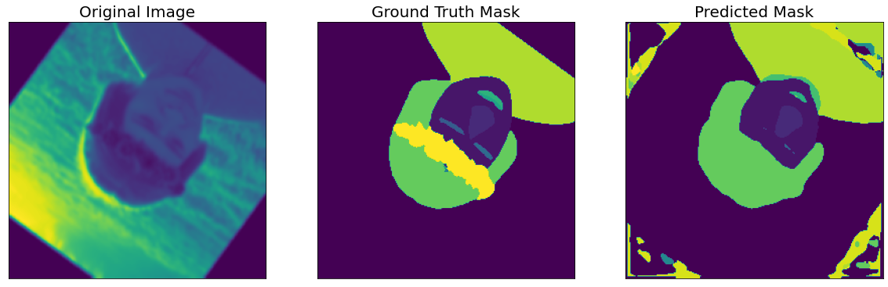
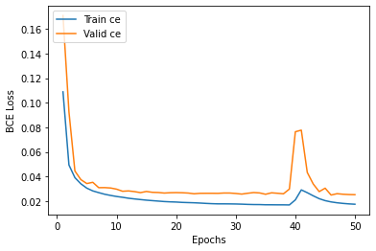
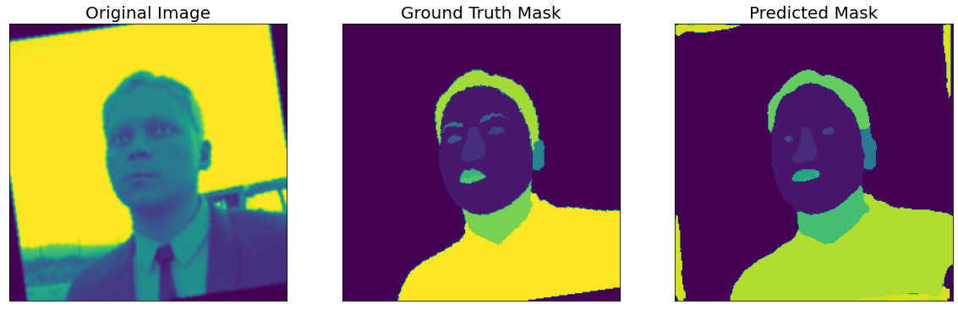
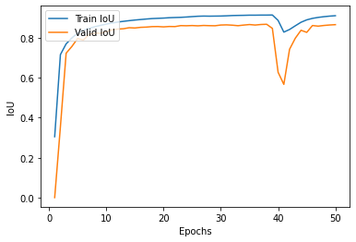
Deeplab+
Epoch: 50
train: 100%|██████████| 10/10 [00:04<00:00, 2.38it/s, bce_loss - 0.01746, iou_score - 0.9109]
valid: 100%|██████████| 3/3 [00:00<00:00, 5.52it/s, bce_loss - 0.02522, iou_score - 0.8661]
0.001 alpha
5 batch size
50 epoch
BCE loss
Full Augmentation
MEAN IoU: 0.2941289
MEAN IoU: 0.38324133

Slide 22
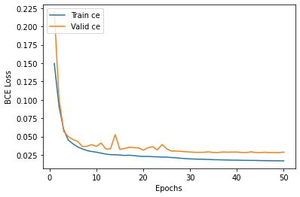
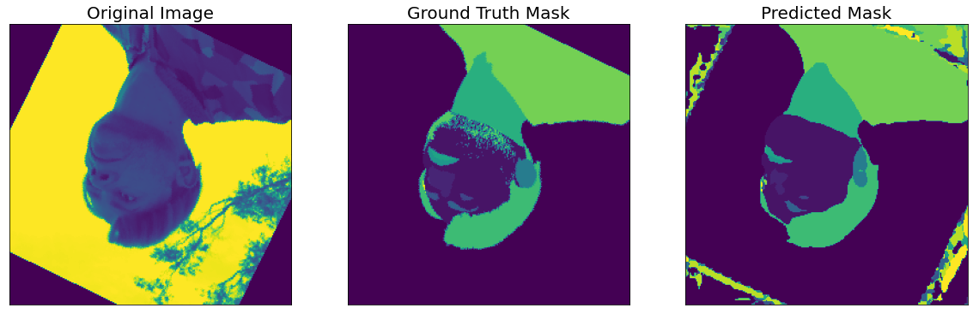
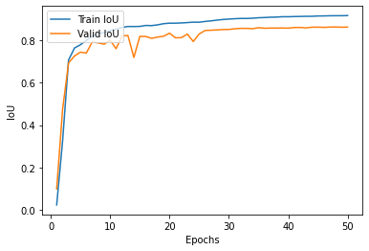
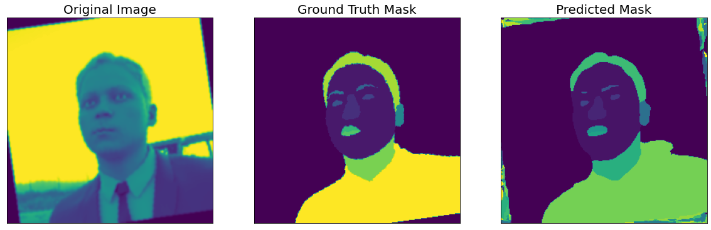
Unet
Epoch: 50
train: 100%|██████████| 10/10 [00:04<00:00, 2.18it/s, bce_loss - 0.01691, iou_score - 0.9183]
valid: 100%|██████████| 3/3 [00:00<00:00, 5.49it/s, bce_loss - 0.02881, iou_score - 0.8637]
MEAN IoU: 0.263201
MEAN IoU: 0.3373418

Slide 23
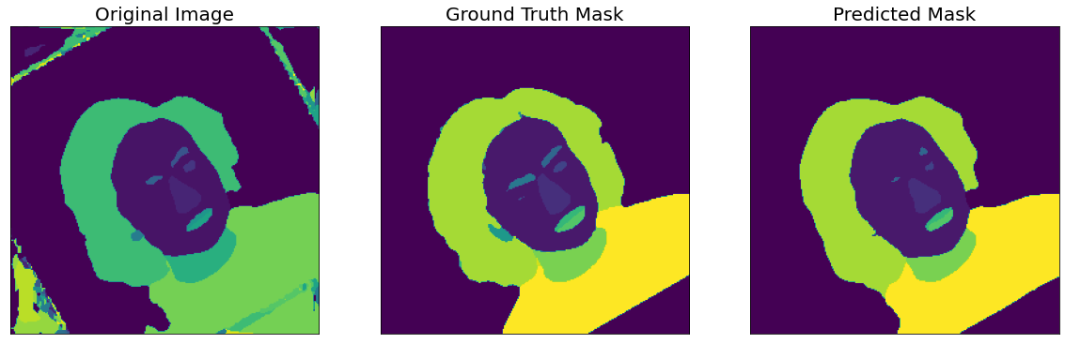
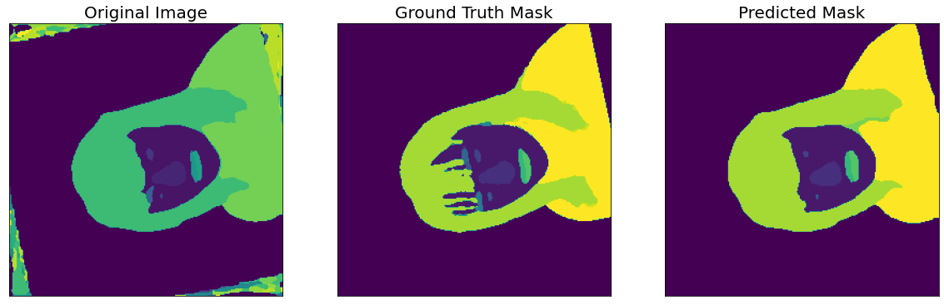
Label Adapter (Wood, Deeplab)
Epoch: 50
train: 100%|██████████| 32/32 [00:03<00:00, 8.99it/s, bce_loss - 0.007583, iou_score - 0.9474]
valid: 100%|██████████| 20/20 [00:00<00:00, 34.65it/s, bce_loss - 0.027, iou_score - 0.8792]
MEAN IoU: 0.47581023
MEAN IoU: 0.42071274

Slide 24
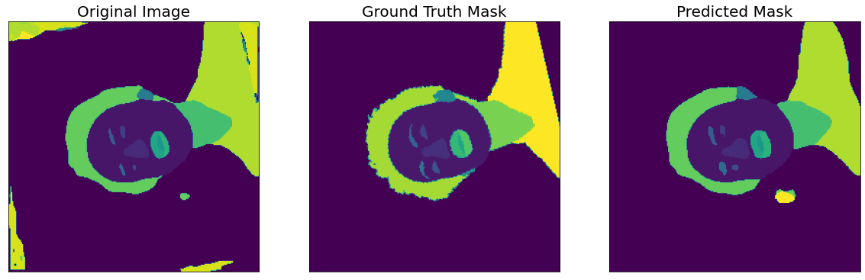

Label Adapter (Wood, Unet)
Epoch: 50
train: 100%|██████████| 32/32 [00:03<00:00, 9.13it/s, bce_loss - 0.007947, iou_score - 0.9456]
valid: 100%|██████████| 20/20 [00:00<00:00, 35.21it/s, bce_loss - 0.0249, iou_score - 0.88]
MEAN IoU: 0.47256178
MEAN IoU: 0.3874198

Slide 25
Helen*

Slide 26




DeepLabV3+ (Helen*)
Epoch: 50
train: 100%|██████████| 11/11 [00:06<00:00, 1.57it/s, bce_loss - 0.02592, iou_score - 0.933]
valid: 100%|██████████| 4/4 [00:00<00:00, 4.98it/s, bce_loss - 0.05723, iou_score - 0.8466]
MEAN IoU: 0.42477095
MEAN IoU: 0.46194646

Slide 27




Unet (Helen*)
Epoch: 50
train: 100%|██████████| 11/11 [00:06<00:00, 1.57it/s, bce_loss - 0.02408, iou_score - 0.9407]
valid: 100%|██████████| 4/4 [00:00<00:00, 4.98it/s, bce_loss - 0.06019, iou_score - 0.8469]
MEAN IoU: 0.43558362
MEAN IoU: 0.41372606

Slide 28




Label Adapter (Helen*, Deeplab)
Epoch: 50
train: 100%|██████████| 2/2 [00:00<00:00, 2.59it/s, bce_loss - 0.01667, iou_score - 0.9358]
valid: 100%|██████████| 1/1 [00:00<00:00, 10.74it/s, bce_loss - 0.0539, iou_score - 0.8609]
MEAN IoU: 0.32374164
MEAN IoU: 0.40851286

Slide 29




Label Adapter (Helen*, Unet)
Epoch: 50
train: 100%|██████████| 2/2 [00:00<00:00, 2.62it/s, bce_loss - 0.01603, iou_score - 0.9383]
valid: 100%|██████████| 1/1 [00:00<00:00, 10.90it/s, bce_loss - 0.06813, iou_score - 0.8357]
Model saved!
MEAN IoU: 0.48009518
MEAN IoU: 0.37349173

Slide 30
LaPa

Slide 31




LaPa (DeepLabV3+)
Epoch: 50
train: 100%|██████████| 6/6 [00:03<00:00, 1.70it/s, bce_loss - 0.02668, iou_score - 0.9294]
valid: 100%|██████████| 2/2 [00:00<00:00, 4.95it/s, bce_loss - 0.04751, iou_score - 0.8676]
Model saved!
MEAN IoU: 0.41499388
MEAN IoU: 0.4072713

Slide 32





LaPa (Unet)
Epoch: 50
train: 100%|██████████| 6/6 [00:03<00:00, 1.70it/s, bce_loss - 0.02515, iou_score - 0.9357]
valid: 100%|██████████| 2/2 [00:00<00:00, 4.96it/s, bce_loss - 0.04912, iou_score - 0.8642]
MEAN IoU: 0.51347536
MEAN IoU: 0.37456694
MEAN IoU: 0.399821

Slide 33




Label Adapter(LaPa Deeplab)
Epoch: 15
train: 100%|██████████| 2/2 [00:00<00:00, 2.55it/s, bce_loss - 0.03314, iou_score - 0.8911]
valid: 100%|██████████| 1/1 [00:00<00:00, 10.35it/s, bce_loss - 0.05955, iou_score - 0.8279]
Model saved!
MEAN IoU: 0.22485405
MEAN IoU: 0.23931076

Slide 34




Label Adapter(LaPa Unet)
Epoch: 50
train: 100%|██████████| 2/2 [00:00<00:00, 2.58it/s, bce_loss - 0.01429, iou_score - 0.9467]
valid: 100%|██████████| 1/1 [00:00<00:00, 10.11it/s, bce_loss - 0.05561, iou_score - 0.8624]
MEAN IoU: 0.34184927
MEAN IoU: 0.31700447

Slide 35
Domain Mixed
80% 70% 60% 50%

Slide 36




Mixed (DeepLabv3+) 80% mixed
Epoch: 50
train: 100%|██████████| 6/6 [00:04<00:00, 1.47it/s, bce_loss - 0.0172, iou_score - 0.9119]
valid: 100%|██████████| 2/2 [00:00<00:00, 3.74it/s, bce_loss - 0.03106, iou_score - 0.8408]
Model saved!
MEAN IoU: 0.2922916
MEAN IoU: 0.32179806

Slide 37




Mixed (DeepLabv3+) 70% mixed
Epoch: 50
train: 100%|██████████| 10/10 [00:04<00:00, 2.36it/s, bce_loss - 0.0158, iou_score - 0.9215]
valid: 100%|██████████| 3/3 [00:00<00:00, 5.48it/s, bce_loss - 0.0314, iou_score - 0.8396]
MEAN IoU: 0.56508833
MEAN IoU: 0.33722326

Slide 38




Mixed (DeepLabv3+) 60% mixed
Epoch: 50
train: 100%|██████████| 11/11 [00:04<00:00, 2.36it/s, bce_loss - 0.01571, iou_score - 0.9222]
valid: 100%|██████████| 3/3 [00:00<00:00, 5.06it/s, bce_loss - 0.0317, iou_score - 0.8401]
MEAN IoU: 0.24888505
MEAN IoU: 0.35794842

Slide 39




Mixed (DeepLabv3+) 50% mixed
Epoch: 50
train: 100%|██████████| 10/10 [00:04<00:00, 2.36it/s, bce_loss - 0.01577, iou_score - 0.9216]
valid: 100%|██████████| 3/3 [00:00<00:00, 5.54it/s, bce_loss - 0.02935, iou_score - 0.8452]
MEAN IoU: 0.41376054
MEAN IoU: 0.22893834

Slide 40


Mixed (Unet) 50% mixed
Epoch: 50
train: 100%|██████████| 10/10 [00:04<00:00, 2.16it/s, bce_loss - 0.01929, iou_score - 0.8993]
valid: 100%|██████████| 3/3 [00:00<00:00, 5.50it/s, bce_loss - 0.0357, iou_score - 0.8103]

Slide 41



Label Adapter - Mixed (Deeplab) 50%
Epoch: 50
train: 100%|██████████| 2/2 [00:00<00:00, 2.08it/s, bce_loss - 0.01172, iou_score - 0.9273]
valid: 100%|██████████| 1/1 [00:00<00:00, 7.51it/s, bce_loss - 0.02584, iou_score - 0.868]
MEAN IoU: 0.2905077

Slide 42




Label Adapter - Mixed (Unet) 50%
Epoch: 50
train: 100%|██████████| 2/2 [00:00<00:00, 2.05it/s, bce_loss - 0.01075, iou_score - 0.9324]
valid: 100%|██████████| 1/1 [00:00<00:00, 6.48it/s, bce_loss - 0.03417, iou_score - 0.8506]
MEAN IoU: 0.30805433
MEAN IoU: 0.26045868

Slide 43
Week 3

Slide 44

1000 Image Helen-Trained Results
Model | Test IoU | Transfer Iou
DeepLabV3+ (30% AUGMENTED) | 0.51959 | 0.22325
Unet (30% AUGMENTED) | 0.5208428 | 0.22388
DeepLabV3+ (NOT AUGMENTED) | 0.541088 | 0.23715
Unet (NOT AUGMENTED) | 0.532055 | 0.23331
Model | Background | Skin | Left Brow | Right Brow | Left Eye | Right Eye | Nose | Upper Lip | Inner Mouth | Lower Lip | Hair
DeepLabV3+ (NO AUG) | 0.9997 | 0.9355 | 0.51454175 | 0.515259 | 0.532706 | 0.546320 | 0.86173 | 5298904 | 0.4287 | 0.6099127 | 0.8183795
DeepLabV3+ (NO AUG,) ADAPTED | 0.99953 | 0.934493 | 0.25083 | 0.289619 | 0.2445 | 0.24564 | 0.6976 | 0.2771 | 0.2030 | 0.3742 | 0.9043
DeepLabV3+ (AUGS30%) | 0.9992 | 0.9319 | 0.2850 | 0.2677 | 0.2603 | 0.2603 | 0.699 | 0.3007 | 0.250 | 0.3633 | 0.883
DeepLabV3+ (AUGS 50%) | 0.9989 | 0.9323 | 0.2467 | 0.2566 | 0.25021 | 0.2617 | 0.6852 | 0.285 | 0.238 | 0.3598 | 0.866
Wood et al. (helen) |  | 95.1 | 81.5 |  | 87.6 |  | 94.7 | 81.6 | 87.0 | 88.9
*Helen test ds contains 100 images
*iBugMask contains 1000 images

Slide 45
Model | Dataset | Background | Skin | Left Brow | Right Brow | Left Eye | Right Eye | Nose | Upper Lip | Inner Mouth | Lower Lip | Hair | av
DeepLabV3+ (NO AUG) | Helen (2000/2000) | 0.988 | 0.948 | 0.5904 | 0.607 | 0.608 | 0.6288 | 0.905 | 0.593 | 0.581 | 0.7106 | 0.9176 | 0.7346
Wood et al. | helen |  | 95.1 | 81.5 |  | 87.6 |  | 94.7 | 81.6 | 87.0 | 88.9 |  | 91.6
DeepLabV3+ (NO AUG) | Lapa (5,000/18,000) | 0.985 | 0.9551 | 0.596 | 0.632 | 0.581 | 0.595 | 0.914 | 0.658 | 0.632 | 0.7119 | 0.9192 | 0.744
Wood et al. | LaPa |  | 97.5 | 89.3 | 89.3 | 91.4 | 91.5 | 96.9 | 87.3 | 89.8 | 89.4 | 86.9 | 90.9

Slide 46
Helen (Crop)
Dataset F1 = [0.9505782 0.882177 0.47131467 0.4651059 0.5282453 0.5007292
0.78394425 0.49502012 0.47808638 0.56844634 0.7886488 ]
Dataset F1 av = 0.62839055
Label adapted
Dataset MIoU = 0.588542616698477
Dataset F1 = [0.87000954 0.9414106 0.60580474 0.61195934 0.60813844 0.62706643
0.90913105 0.61581224 0.47403285 0.7052058 0.77178097]
Dataset F1 av = 0.70366836
2 Helen val crop aug
Dataset F1 = [0.94977224 0.95328236 0.71694857 0.74778265 0.75271463 0.7712925
0.9332825 0.75021607 0.4740555 0.82364756 0.8132537 ]
Dataset F1 av = 0.7896589
Dataset F1 = [0.7991823 0.93681926 0.646416 0.6798886 0.68266314 0.7233338
0.9134503 0.7278079 0.4712311 0.7719496 0.7205498 ]
Dataset F1 av = 0.7339356
Label adapted
test
3 Helen val crop no aug
Dataset F1 = [0.90423596 0.96016866 0.64318186 0.68956935 0.7006519 0.71861917
0.92619765 0.72278255 0.47666296 0.79642075 0.8212452 ]
Dataset F1 av = 0.75997597
Dataset MIoU = 0.6659741724077055
Dataset F1 = [0.90423596 0.96016866 0.64318186 0.68956935 0.7006519 0.71861917
0.92619765 0.72278255 0.47666296 0.79642075 0.8212452 ]
Dataset F1 av = 0.75997597
Label adapted

Slide 47




Slide 48
Dataset F1 = [0.9702566 0.9265864 0.55399907 0.56836325 0.5702391 0.57496643
0.8755424 0.5611879 0.51082563 0.62456554 0.82941955]
Dataset F1 av = 0.6878138
Dataset F1 = [0.97329515 0.91320914 0.55918604 0.5290696 0.63028276 0.59890074
0.8917184 0.56509316 0.66011566 0.8031365 0.6752579 ]
Dataset F1 av = 0.7090241
Usually for the case of one-hot labels, one uses the softmax activation function. Mathematically, softmax has asymptotes at 0 and 1, so singularities do not occur. As a matter of floating point arithmetic, overflow can occasionally result in
log(1)
log⁡(1) or
log(0)
log⁡(0). Usually these are avoided by rearranging the equations and working on a different scale, such as the logits (e.g. https://www.tensorflow.org/api_docs/python/tf/nn/softmax_cross_entropy_with_logits)

Slide 49


Slide 50
What hassan has suggested is not correct - Categorical Cross-Entropy loss or Softmax Loss is a Softmax activation plus a Cross-Entropy loss. If we use this loss, we will train a CNN to output a probability over the C classes for each image. It is used for multi-class classification.
What you want is multi-label classification, so you will use Binary Cross-Entropy Loss or Sigmoid Cross-Entropy loss. It is a Sigmoid activation plus a Cross-Entropy loss. Unlike Softmax loss it is independent for each vector component (class), meaning that the loss computed for every CNN output vector component is not affected by other component values. That’s why it is used for multi-label classification, where the insight of an element belonging to a certain class should not influence the decision for another class.
Now for handling class imbalance, you can use weighted Sigmoid Cross-Entropy loss. So you will penalize for wrong prediction based on the number/ratio of positive examples.

Slide 51










0 / 5
1 / 5
2 / 5
3 / 5
4 / 5

Slide 52





